Slide 2
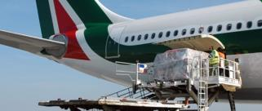
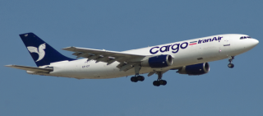
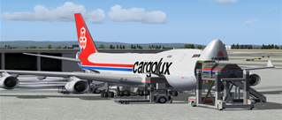
Our History
More Than 40 Years’ Experience
Founded in 1970 as Freight Forwarding Agency specialized in air shipments
Alitalia Cargo General Sales Agent in Liguria from its establishment until 2009
Iran Air Cargo General Sales Agent 2007-2009
Cargolux handler in Genoa Airport from 2012 to 2015

Slide 3
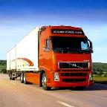
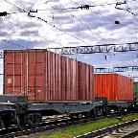
«There is only one boss. The customer. And he can fire everybody in the company from the chairman on down, simply by spending his money somewhere else.»
(Sam Walton - Founder of Wal-Mart Stores Inc.)
Services and Goals
Our mission is to reach our Customers’ satisfaction in every step of the shipment;
Our Customers’ goals become our goals, our Customers’ success becomes our success.
CMA offers a wide range of solutions for all shipments, integrating different transport modes by air, by sea and by land, thus moving your goods in the most efficient and effective way.

Slide 4
Why choose CMA?
A global network of logistics experts with qualified knowledge of local markets
Emerging Markets
Capabilities
Network with over 500 locations, but without losing flexibility or customer care
Logistics and freight transport and tailor-made solutions dedicated to the customer
Global
Network
Specialist
Logistics
Solutions
Personalized service and continuous search for the best solutions
Focus on Personal
Service
Innovative spirit, global quality standards and qualified personnel
Entrepreneurial
Spirit

Slide 5
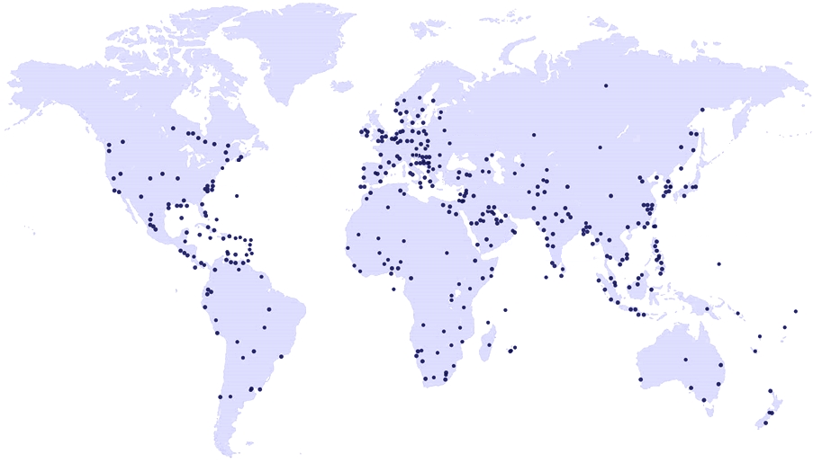
Il Network
London
Vancouver
Montreal
Milan
Beijing
New York
Tokyo
Los Angeles
Tel Aviv
Miami
Cairo
Shanghai
Dubai
Doha
Hong Kong
Lagos
Singapore
Lima
Sao Paolo
Perth
Sydney
Santiago
Buenos Aires
Melbourne
Johannesburg
CMA-Compagnia Merci Aeree is commercial partner of AGILITY Logistics s.r.l, worldwide network with more than 550 offices in over 100 country .
Agility netwotk allows CMA-Compagnia Merci Aeree to meet any customer need, from usual door to door import/export to cross-trade operation .

Slide 6
In Italy
Malpensa
Milan
Verona
Turin
Bologna
Ancona
Head Office in Genoa
P.zza della Vittora 14/7
Genoa
Genoa Airport «C. Colombo» office
Rome
8 national agents
Naples
Collections and deliveries throughout Italy
Departures / Arrivals from/to all national Airports/Ports

Slide 7
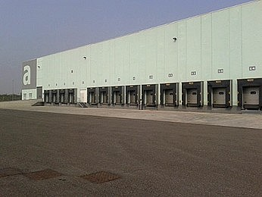
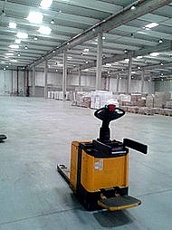
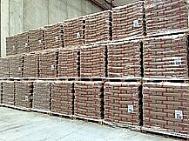
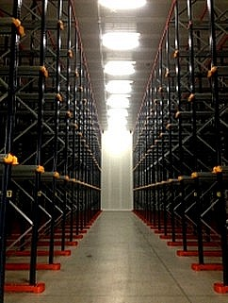
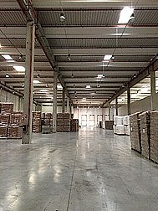
Warehouse
25,000 sqm warehouse in Tortona (AL)
Automated loading bays for an easy cargo handling
2000 sqm dedicated to bio food
Private certified weighbridge for Vgm purposes, connected to main port terminals
24/7 surveillance with security staff and CCTV systems

Slide 8
ROAD & RAIL
Import - Export
Cross Trade
Door to Door
ADR Transport
Groupage and Courier Service
Dedicated Truck
Special Trasport
Railroad Container/Wagon

Slide 9
SEA FREIGHT
Import - Export
Cross Trade – Door to Door
FCL, LCL, Break Bulk
Ro-Ro Service
IMO Shipments
Consolidated Destinations

Slide 10
AIR FREIGHT
Direct / Consolidated Shipment
Track and Trace
Import - Export
Cross Trade – Door to Door
DGR Trained Staff
Special Cargo

Slide 11
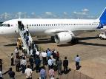
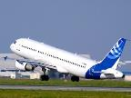
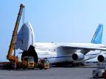
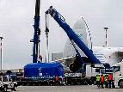
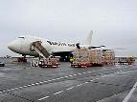
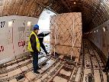
CHARTERS
Cargo , AOG Charters
Time Critical Spares Delivery
Passenger , VIP and Business Charters

Slide 12
Compagnia Merci Aeree Srl
Piazza della Vittoria 14/7
16121 Genoa - Italy
Tel.: +39 010 600891
Fax: +39 010 6502308
Web:
www.cmagoa.it
Email
General: cma@cmagoa.it
Charter: aldo.valtolina@cmagoa.it simone.valtolina@cmagoa.it
Sales Manager: enrico.martino@cmagoa.it
Export: mauro.zanetti@cmagoa.it
Import - X-trade: fabia.monaca@cmagoa.it

